Slide 1

CMR COLLEGE OF ENGINEERING & TECHNOLOGY
Kandlakoya, Medchal, Hyderabad - 501401
Department of Computer Science and Engineering
TRACKER AND TRIGGERER APP
Under esteemed guidance of
- L. CHANDRA SEKHAR REDDY
S.Sree (19H51A0556)
S.Abhinav(19H51A0557)
B.Snigdha (19H51A0558)

Slide 2
Abstract

Slide 3
Abstract
‘Tracker and Triggerer’ is an android app to keep track of the regular activities and to help people in managing their daily chores. This app can be used to manage groceries, kitchen appliances, home maintenance details. Users of the app can keep track of their groceries with quantity, books, furniture, grooming materials, medical reports and others with images. It provides a customised message with the necessary list of documents to the mobile number as well as mail id one hour before for meetings and other to-do activities scheduled. The user can then share the image and other details of any material or appliances which is available in their to-do list with their family, friends, relatives and colleagues through Gmail or WhatsApp.

Slide 4
Introduction

Slide 5
Introduction
In a modern household, due to hectic work schedules, it is quite difficult to remember as well as manage the chores and responsibilities in an urban home.
Working professionals, homemakers, job-seekers etc. all fail to keep track of their inventories or scheduled meetings which in turn either delay or terminate their regular duties.
Sometimes, most people forget that they already have sufficient stock of certain item, and end up re-buying the same stuff again (toothpaste, soap, face wash, etc.) as a result lose money and time.
The inability of efficiently managing the home inventories will not only impact work schedules, but also causes stress, anger, and impatience. An automated application is proposed and intended to develop in order to keep track of the regular activities and aid people in managing the daily home inventories.

Slide 6
Objective
The main objective of this project is to remind the people what needs to be done now.
To remove the workload that is kept on the brain and give reminders in scheduled time.
To have a track of necessary groceries and general usage of items .
To have a track of medical prescriptions and books.

Slide 7
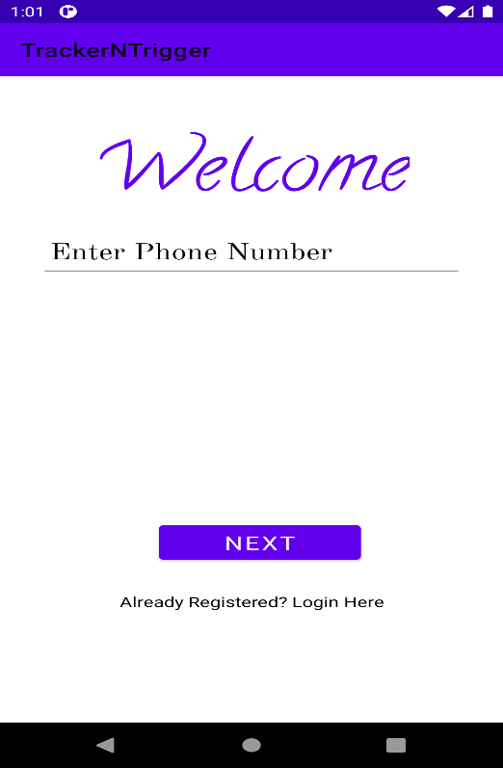
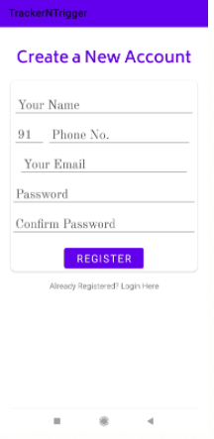
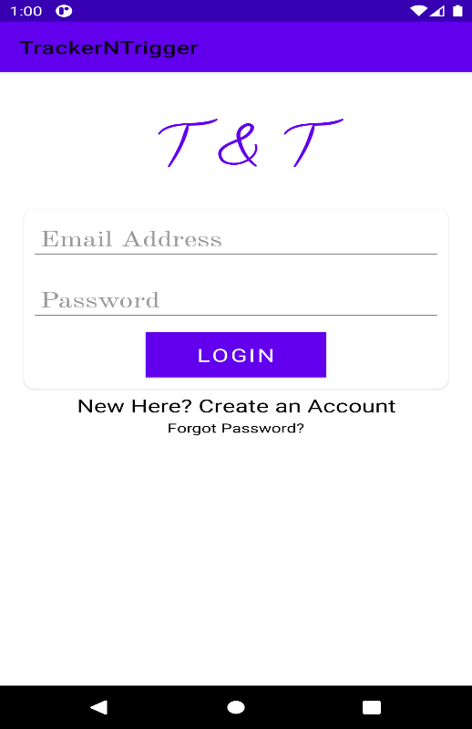
Implementation

Slide 8
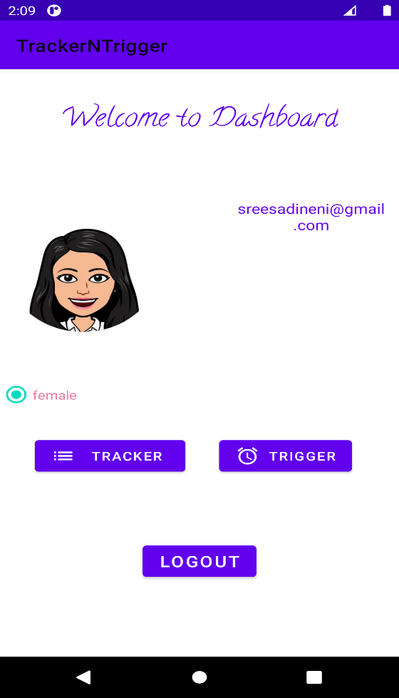
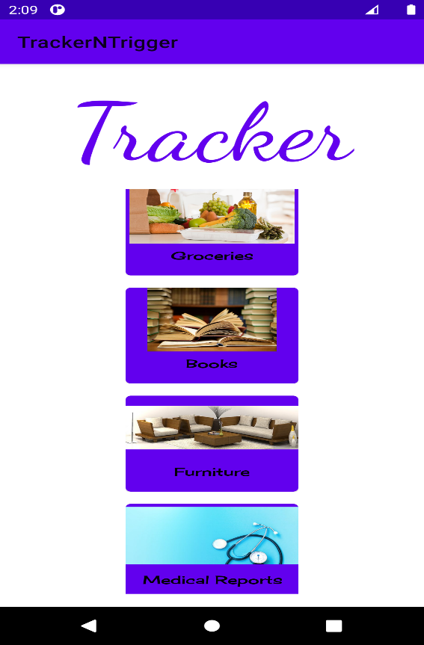
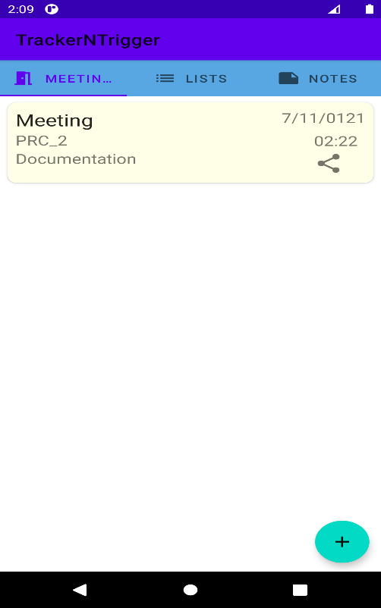

Slide 9
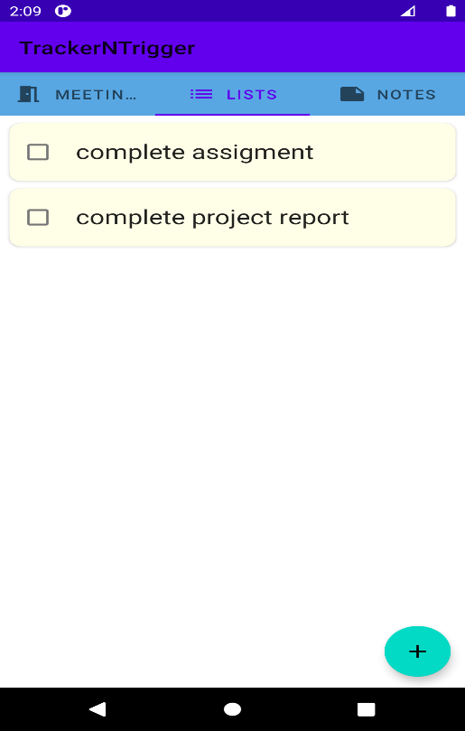
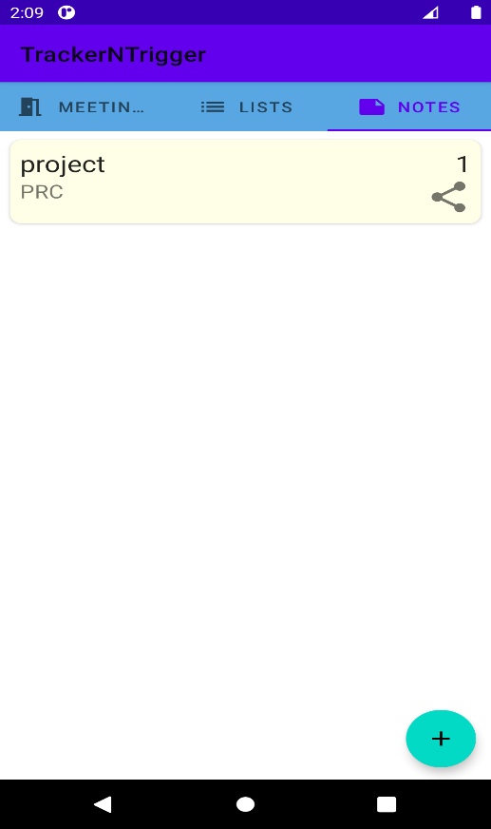

Slide 10
Scope and Limitation of Study
This application helps us to know what should be done at what time with a gentle reminder.
We don’t need to remember everything as this application intimates us about what we should do.
Advantages
Easy to use and free
Covers all the fields like healthcare , maintenance and home appliances
No advertisements and harmful API’s.

Slide 11
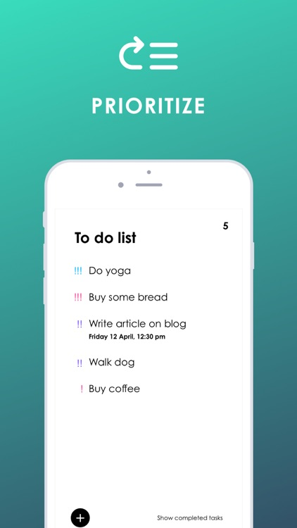
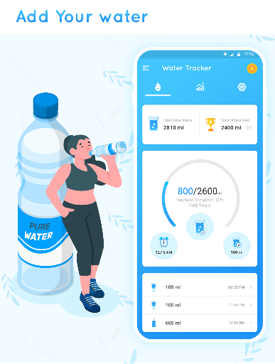
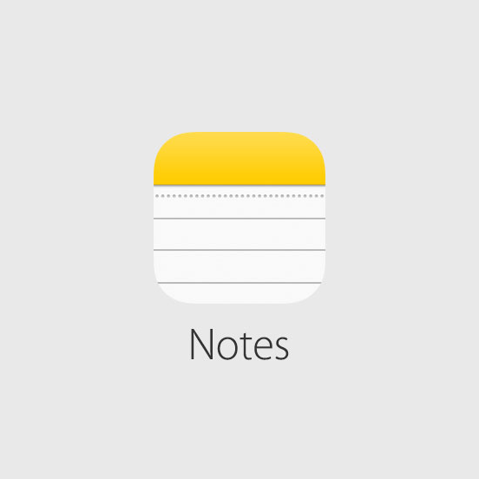
Existing Systems
TO DO LIST
Water Reminder App
Maintenance App
Notes
Disadvantages
Limited only for a particular use of field such as healthcare , maintenance and home appliances.
Most of them are paid apps .
Contains a lot of advertisements and not secure.

Slide 12
THANK YOU

